Slide 1


5 June 2011
Muscat, Sultanate of Oman

Slide 2

Introduction
As the country’s first environmental initiative of its kind, the Oman Green Awards was created to increase green awareness and motivate behavioral change for the protection and preservation of our environment.
The initiative champions outstanding environmental vision, endeavors, initiatives and achievements by businesses, institutions and individuals active in promoting and implementing environmental programs.
The role of organizations in environmental protection and preservation through responsible and sustainable consumption of natural resources cannot be discounted, and the adoption of environmentally sound technologies, policies and practices is a must to protect the natural resource that we call earth.
Oman Green Awards is the ultimate recognition for companies, institutions and individuals in Oman, who demonstrate a commitment towards responsible consumption and sustainable growth. The initiative honors and celebrates their vision in leading the way to a cleaner, greener tomorrow.

Slide 3




Oman Green Awards 2010 held in Association With
Ministry of Environment & Climate Affairs
Ministry of Health,
Dept. of Environmental & Occupational Health
Muscat Municipality
Environment Society of Oman

Slide 4





Award Categories
For the most original idea for environmental protection
For the best public awareness campaign
For the most eco-friendly and healthy workplace
For the best green cause contribution by an individual
For the best environment conservation research

Slide 5




Award Categories
For the most eco-friendly utility landscapes
For companies who have developed and implemented ways to effectively reduce or offset their carbon footprint
For the best environmental education practices
For the best organization to strongly espouse environmental protection, preservation and conservation values through eco-friendly practices at the workplace and in the community

Slide 6

The Judging Panel
The panel independently scrutinized each and every entry, assessing each initiative’s:
Effectiveness,
Innovation and creativity
Impact
Originality and leadership
Continuity and sustainability.
The panel members:
Mr. Ali Al Kiyumi, Director General for Nature Conservation, Ministry of Environment and Climate Affairs,
Dr. Salim Al Wahaibi, Director of the Environmental and Occupational Health Department, Ministry of Health
Dr. Mushataq Ahmed, Director, Center of Environmental Studies and Research, Sultan Qaboos University
Dr. Mehdi Jaaffar, VP, Environment Society of Oman
Mr. Mayank Singh, Editor, Oman Economic Review

Slide 7
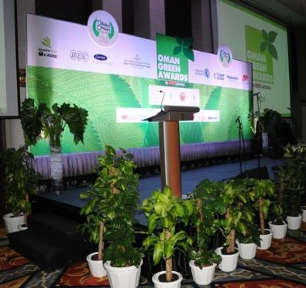
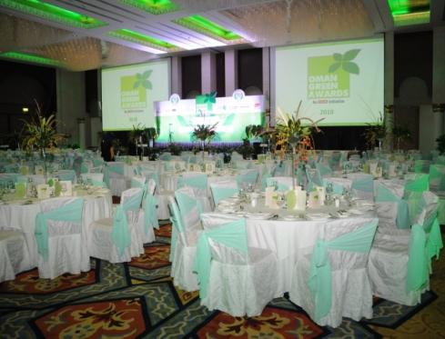
Venue Set-Up
The Stage
The Ballroom

Slide 8

Award Plaque
The Award Plaque presented to the winners was made of disposed banana bark from the Plantain tree, with the certificates printed on 100% recycled paper

Slide 9
OER Oman Green Awards 2011
Brief Overview for 2011: Oman Green Awards 2011, is the ultimate recognition for companies, institutions and individuals in Oman, who demonstrate a commitment towards responsible consumption and sustainable growth. The initiative honors and celebrates their vision in leading the way to a cleaner, greener tomorrow.
Venue: 5* Hotel, Muscat Oman Date: 5th June 2011 – Word Environment Day Participants: Entries will be invited both from companies and individuals, in all the categories. Voluntary efforts and achievements by Individuals and organisations for environmental protection and preservation through responsible and sustainable consumption of natural resources will be honoured, appreciated and promoted.
Benefits: Premium opportunity to partner with the Oman’s first environment awards and to enhance the profile of your company, act as environmental ambassadors and setting an example for the Oman Business and Social community to take part in creating a sustainable lifestyle.

Slide 10
Oman Green Awards 2011 held in Association With
Ministry of Environment & Climate Affairs
Ministry of Health,
Dept. of Environmental & Occupational Health
Muscat Municipality
Environment Society of Oman

Slide 11
Award Categories
For the most original idea for environmental protection
For the best public awareness campaign
For the most eco-friendly and healthy workplace
For the best green cause contribution by an individual
For the best environment conservation research

Slide 12
Award Categories
For the most eco-friendly utility landscapes
For companies who have developed and implemented ways to effectively reduce or offset their carbon footprint
For the best environmental education practices
For the best organization to strongly espouse environmental protection, preservation and conservation values through eco-friendly practices at the workplace and in the community

